Slide 1
Introduction to Windows Containers in Kubernetes
Michael Michael

Slide 2

Who Are We?
Michael Michael
SIG-Windows Co-Chair
Director of PM, VMware
@m2 on K8s Slack

Slide 3
Agenda
Where we are today
Continuous Improvement
CSI Update
containerd Update
Perf Update
Future Roadmap

Slide 4
Why deploy Windows on K8s?
​Make Kubernetes truly ubiquitous and continue its lead as the top container orchestration platform, supporting all popular programming frameworks
​Operational efficiencies by leveraging existing investments in cloud native tools/solutions
​Knowledge/Training on Kubernetes is transferable to Windows
​Scalable self-service container platform now available for Windows ecosystem
​Windows developers can take advantage of cloud native tools to build and deploy distributed applications faster
​Retain the benefits of application availability while decreasing costs
• Containerize existing .NET apps to eliminate old HW or underutilized servers
• Streamline migration from end-of-support operating systems

Slide 5
Things to Consider
Read the documentation!
Enforce Host\Guest compatibility
Windows kernel major version should match (for now) – use versioned tags, not latest!
Build on Windows Server 2019 = must run on Windows Server 2019
Use NodeSelectors (windows-build) and Taints/Tolerations
Leverage RuntimeClass - defined once per cluster to simplify steering of Linux or Windows pods to the appropriate nodes
Hyper-V isolation coming soon
Resource Consumption
Need higher limits (300Mb min) - need Windows background services per container

Slide 6
History
1.5 - Alpha Release - Kubelet and kube-proxy running on windows. Show the art of the possible despite limitations
1.9 - Beta Release - Tremendous updates in functionality and CNI support
1.14 - Stable Release - Support for adding Windows Server 2019 nodes to Kubernetes
1.15, 1.16, 1.17 - Kubeadm, CSI, runAsUsername, kubectl port-forward, AWS EBS support, Windows Server 1903 support
1.18 – GMSA and runAsUserName to stable, kubeadm to beta, cluster API alpha, CSI Proxy alpha, containerd alpha
1.19 – CSI Proxy to beta, containerd to beta, DSR, Endpoint slices, stability & performance

Slide 7
CSI Update
Use host OS proxy to bypass privileged container limitations
Bulk of the work is in the CSI Proxy component
API versioning support (based on model for Kubernetes code generators)
Versioned API groups to support Disk/Volume/SMB operations
Enhancements in kubelet, CSI node driver registrar & support for direct win32 API and IOCTL calls in csi-proxy using go-bindings
CSI Proxy beta support includes:
AzureDisk CSI Driver
GCE PD CSI Driver
What’s next? Full CI/CD and additional CSI providers (vSphere, AWS, etc)
Notes:
iSCSI support could be added later based on interest

Slide 8
K8s 1.17 CSI Node Plugin Support
CSI Architecture
dockerd
.exe
kubelet
.exe
CSI Node Pod
Windows container
CSI Node Driver Registrar
Windows container
Windows container
CSI Node Plugin
Windows Pod
\\.\pipe\csi-api-version
container
csi-proxy
.exe
container
Windows Host OS
\\?\Volume{UUID}
\\?\UNC\Server\Share
SMB Volumes
SCSI/IDE/iSCSI/FC LUNs

Slide 9
containerd
Today’s benefits:
Align with direction of K8s community and active investments
Optimized and maintained by the Community (including Windows OS team)
Future benefits:
Hyper-V isolation / Secure multi-tenancy
GMSA support

Slide 10
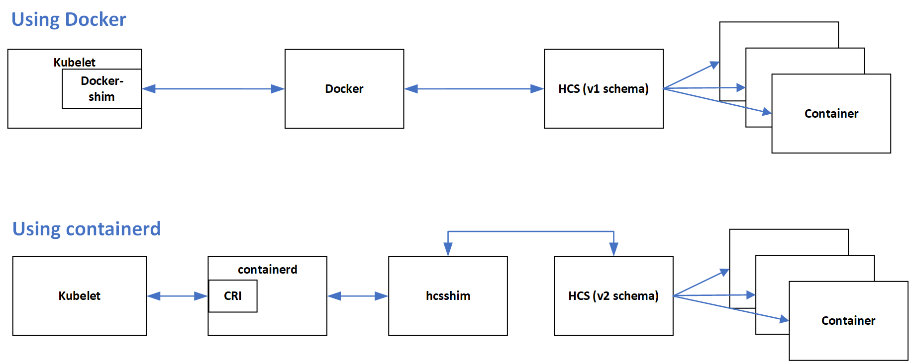
Runtime Architecture
Notes:
Lib container
Additional reasons to move to the containerD path since it supports modern HCSv2
Docker path still uses v1 and v2 remained experimental.

Slide 11
Technology Matrix
Windows Release | Release Type | Kubernetes
Windows Server 2019 | LTSC | v1.14+
Windows Server version 1903 | SAC | v1.17-v1.18
Windows Server version 1909 | SAC | v1.18+
Windows Server version 2004 | SAC | v1.19
For more information, visit the Windows Server servicing info page

Slide 12
Perf & Reliability Improvements
Networking Improvements
Kube-proxy direct server return (DSR) mode
Supports scaling to large # of Services efficiently
Endpoint slices
Supports Services with large # of endpoints efficiently
Performance
Kubelet stats/summary & metrics slowness fixed
CPU Limits honored
Notes:
Notes with PR links
----
Networking Improvements
Kube-proxy direct server return (DSR) mode (#93080)
Supports scaling to large # of Services efficiently
Endpoint slices (#90909)
Supports Services with large # of endpoints efficiently
Performance
Kubelet stats/summary & metrics slowness fixed (#87730)
CPU Limits honored (#86101)

Slide 13
Roadmap
Compute
Keep investing in CRI-ContainerD
Hyper-V isolation support
GPU Support
Deployment & LCM
Promote kubeadm to stable
Cluster API support for Windows worker nodes
Storage & BCDR
Promote CSI work to stable
Add more storage providers to CSI proxy
Light up Velero support with CSI snapshots
Deprecate in-tree storage plugins for Windows

Slide 14
How you can contribute
Join our weekly meetings at 12.30pm Eastern every Tuesday
View the recorded community meetings
Help us write additional documentation and user stories
Find bugs you can fix in our project board (start with “good first issue”)
Review open PRs

Slide 15





Windows Community
Michael Michael
Co-Chair
Director of PM, VMware
@m2 [Slack]
@michmike [GitHub]
Mark Rossetti
Co-Chair
Principal PM, Microsoft
@Mark Rossetti [Slack]
@marosset [GitHub]
Deep Debroy
Technical Lead
Engineering Manager, Docker
@ddebroy [Slack, GitHub]
Slack.k8s.io
#sig-windows
https://groups.google.com/forum/#!forum/kubernetes-sig-windows
https://kubernetes.io/docs/setup/production-environment/windows/
https://github.com/kubernetes/community/tree/master/sig-windows
YouTube Playlist
https://zoom.us/j/297282383
Every Tuesday @ 12.30pm EST

